Slide 1
Feature extraction in Face recognition
Presented by
Submitted to
Name: | Id:
Forhad Ali Emon | 20-44178-2
MD. MAHBUB ALAM SIDDIK | 19-39376-1
Name : Prof. Dr. Md. Asraf Ali
Course: MACHINE LEARNING[D]
American International University Bangladesh
Notes:
assalamualaikum our onarable sir Prof. Dr. Md. Asraf Ali
assalamualaikum to everyone present here.
I am..forhad ali emon.. along with
MD. MAHBUB ALAM SIDDIK
here today I’m present about
Feature extraction in Face recognition

Slide 2
Introduction
Feature extraction is the process of extracting the most important and relevant information from raw data.
Face recognition is the process of identifying or verifying the identity of a person from their face.
Feature extraction is a crucial step in face recognition, as it involves extracting the most relevant and discriminative features from an image
Notes:
There are lots of Feature extraction techniques are available. In this presentation, we will discuss three feature extraction techniques used in face recognition..at first

Slide 3
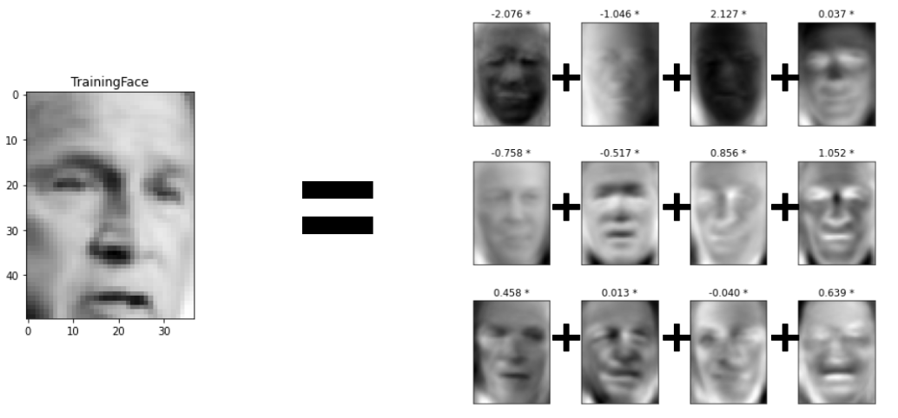

Eigenfaces
Eigenfaces is a technique that uses Principal Component Analysis (PCA) to extract the most significant features from a set of face images.
These features capture the variations in the face images and are used to represent each face as a linear combination of eigenfaces
Notes:
Eigenfaces is computationally efficient and can achieve good performance with relatively small training datasets
$$$Extracted set of images. Combination result

Slide 4
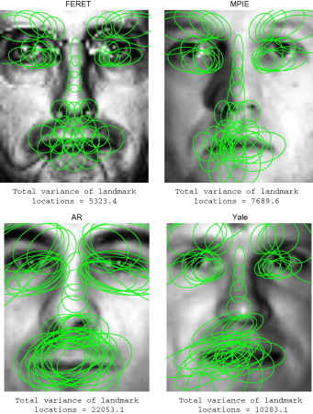
Histogram of Oriented Gradients (HOG)
Histogram of Oriented Gradients (HOG) is a feature descriptor that captures the distribution of edge orientations in an image.
In face recognition, HOG is often used to extract features from facial regions such as the jawline and forehead
Notes:
HOG is computationally efficient and can handle partial occlusions and changes in illumination
$$$captures lots of edge orientations
Actually extract features from facial regions such as the jawline and forehead

Slide 5
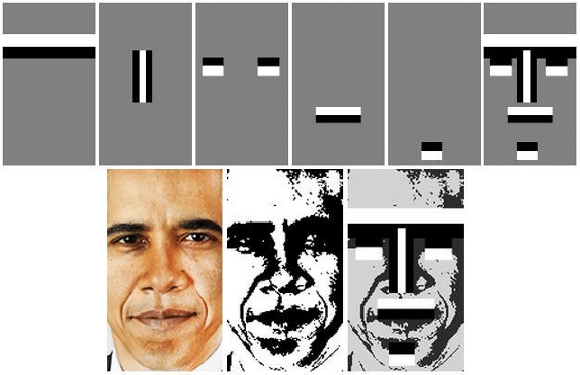
Haar like feature
Haar-like features are used in face recognition to capture variations in brightness levels and textures of facial features.
These features are computed at multiple scales and orientations to capture variations in facial expressions and poses.
Notes:
Haar-like features are often used in conjunction with classifiers to accurately identify faces in images.

Slide 6

Code
this code is a simple implementation of face detection using the Viola-Jones algorithm and OpenCV in Python.

Slide 7

Gray Scale

Slide 8
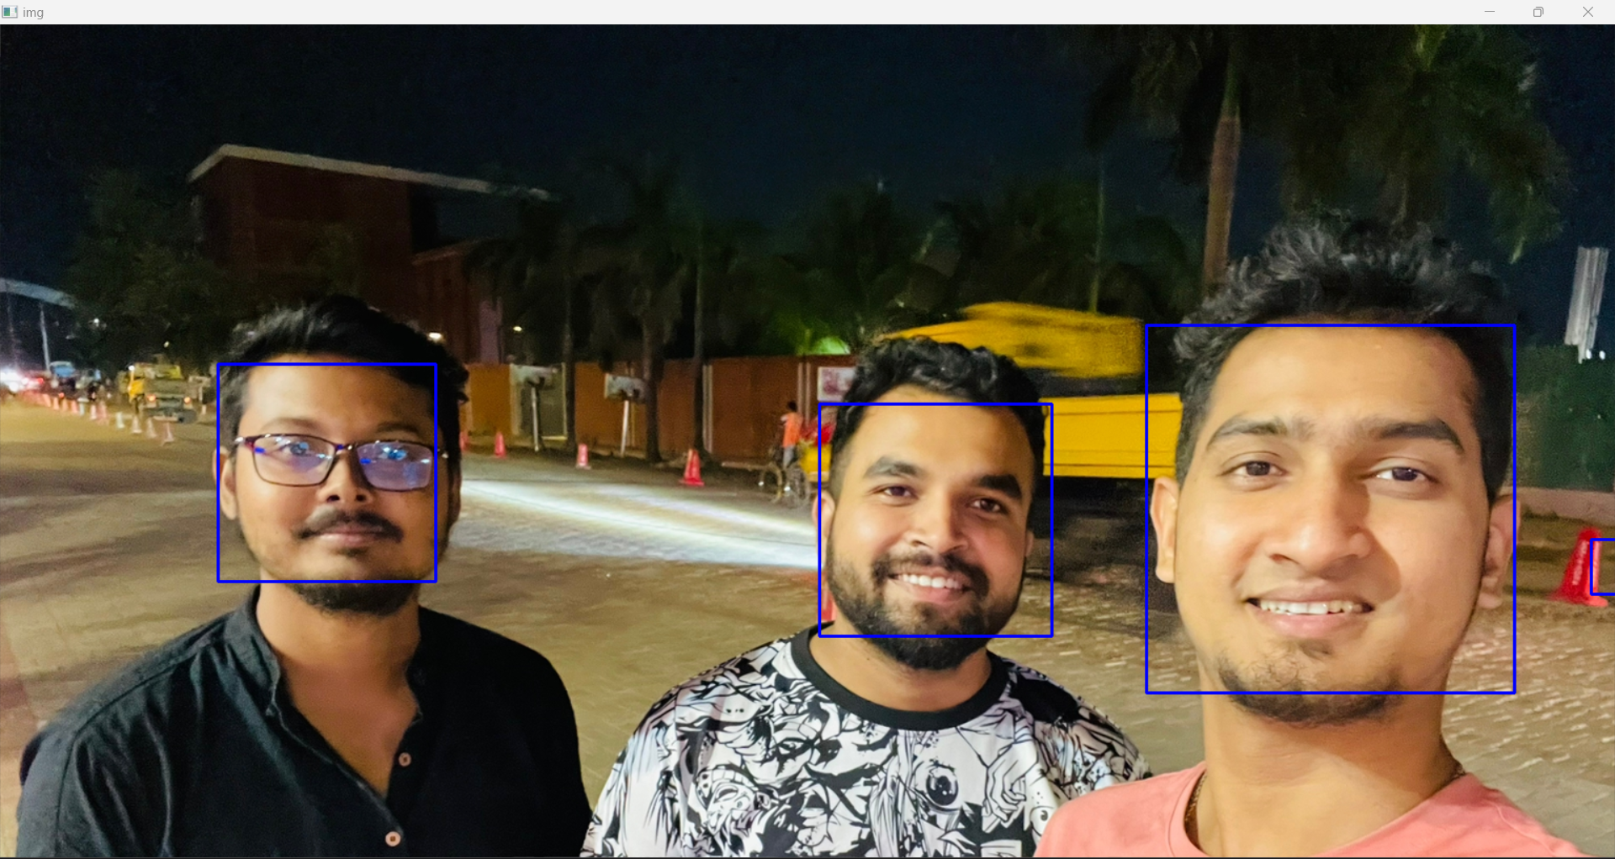
Result
Notes:
Haar-like features can handle variations in lighting, facial expression, and pose, making them useful for face recognition in real-world scenarios.
However, deep learning-based approaches have largely replaced them in recent years, due to their superior performance and flexibility.

Slide 9
Conclusion
There are various feature extraction techniques available, each with its strengths and weaknesses
The choice of technique depends on the specific requirements of the face recognition system, such as the size of the dataset, the complexity of the face variations, and the computational resources available

